Slide 1
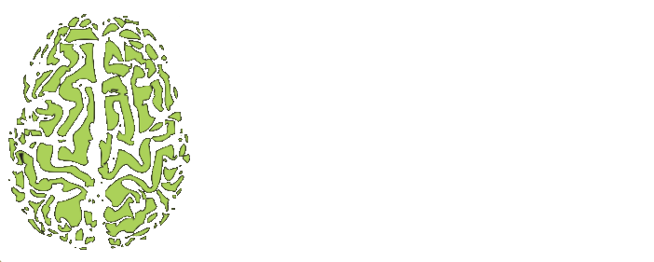

g-Ratio mapping of the optic nerve
Hugo Albert Plante - NeuroPoly

Slide 2
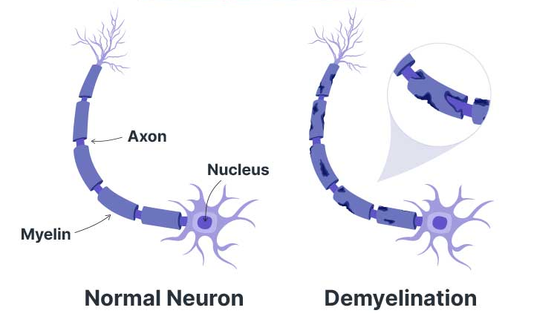
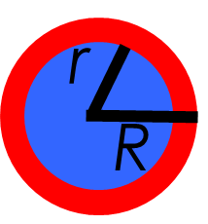
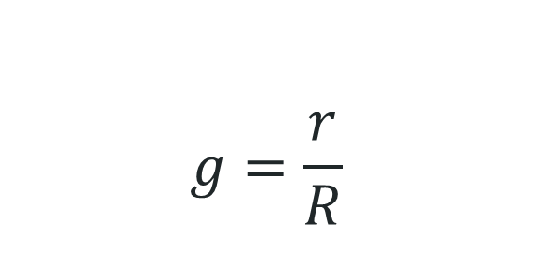
Background
Multiple Sclerosis
g-Ratio
$$g=\frac{r}{R}$$
(Ausmed, 2025)
Notes:
MS : Autoimmune disease that affect 2.8 millions people worldwide. This disease occur when the body’s immune system mistakenly attack the myelin sheath, causing demyelination.
On the other hand, optic neuritis, an inflammation of the optic nerve, is a common early symptom of MS. But as of 2024, Optic Neuritis isn’t just a symptom it’s also a McDonald criteria for diagnosing MS.
How can we detect optic neuritis or microstructural damage in the optic nerve?
This is where the g-ratio come in place. g-Ratio is a key neuroimaging marker representing the ratio between the inner (axon) and outer (myelinated) radius of a nerve fiber.

Slide 3
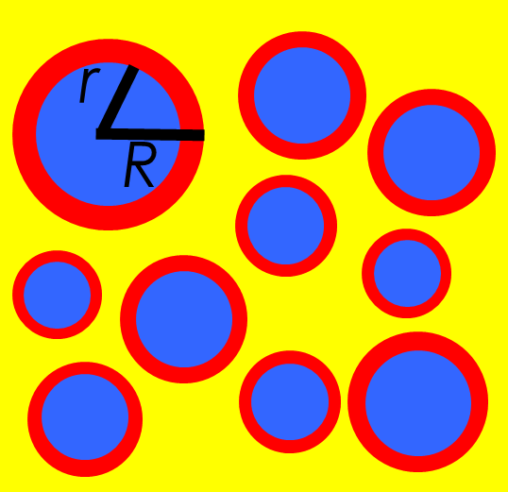
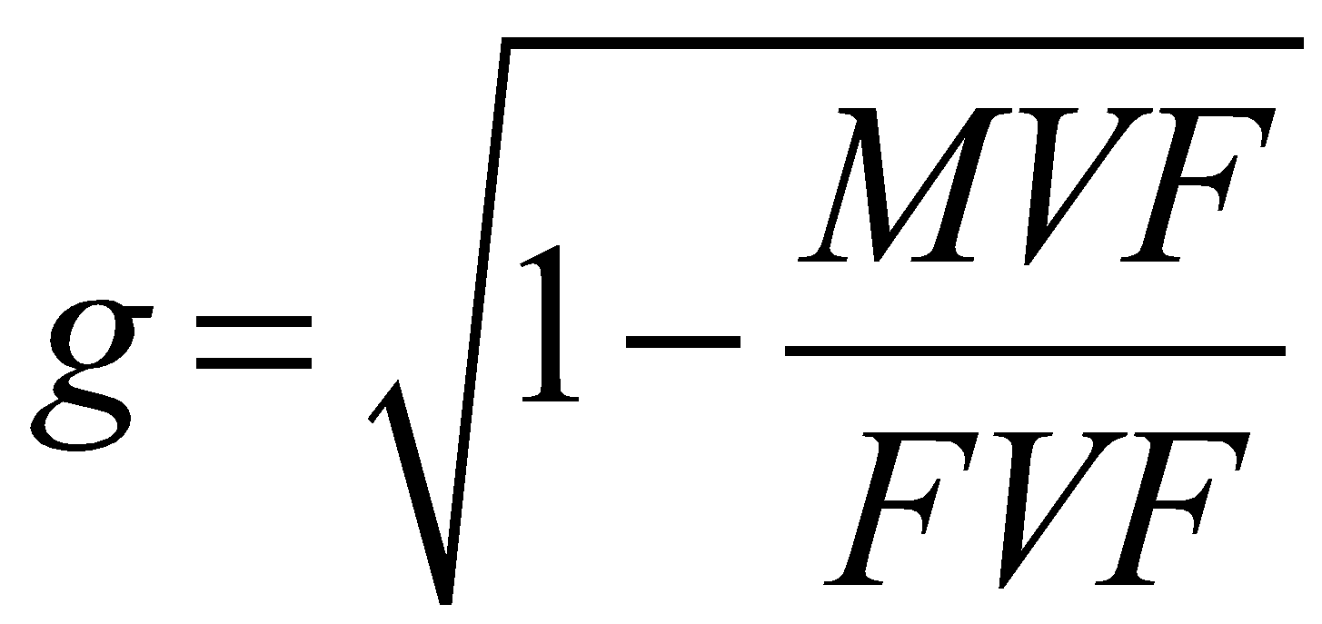
Background
g = r/R
r = Rg
Σ_{i} πR_{i}² (1 − g²)
Σ_{i} πR_{i}² ⁻ Σ_{i} πr_{i}²
Σ_{i} πR_{i}^{2 –} Σ_{i} πR_{i}²g²
Myelin Volume Fraction =
+
+
(MVF)
+
Σ_{i} πR_{i}²
Fiber Volume Fraction =
(FVF)
+
+
MVF/FVF = 1 – g²
(Stikov et al., 2015)

Slide 4
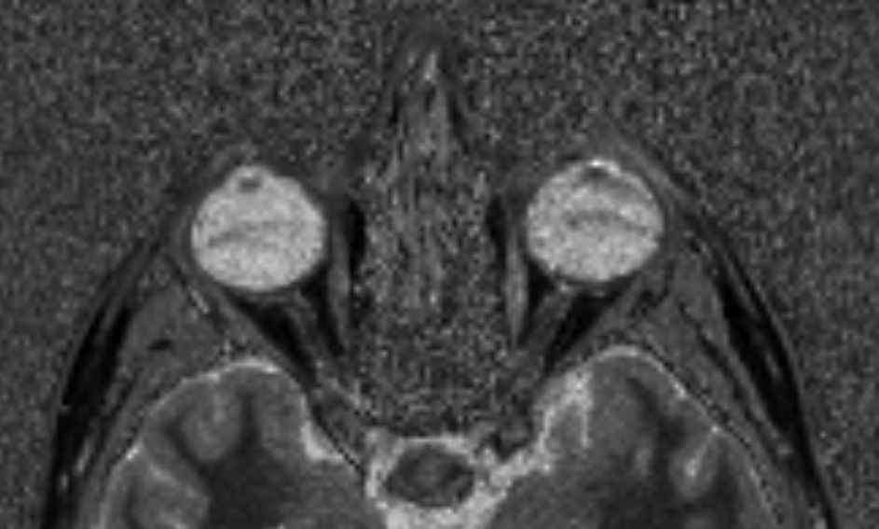
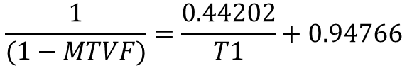
Background
Myelin Volume Fraction (MVF)
Macromolecular Tissue Volume Fraction (MTVF)
$$\frac{1}{(1−MTVF)}=\frac{0.44202}{T1}+0.94766$$
MVF ≈ 50% of MTVF
MP2RAGE ⟹ T1 Map
Axial View of a T1 Map
(Mezer et al., 2013)
Notes:
Accurate g-ratio estimation requires integrating myelin-sensitive and axon-sensitive MRI modalities.
MP2RAGE provides robust T1 mapping, from which myelin volume fraction (MVF) can be derived.
Diffusion-weighted imaging (DWI) allows computation of fractional anisotropy (FA), which correlates with axonal density and enables estimation of the fiber volume fraction (FVF).
Current literature lacks standard methods to fuse these data in small structures like the optic nerve.

Slide 5
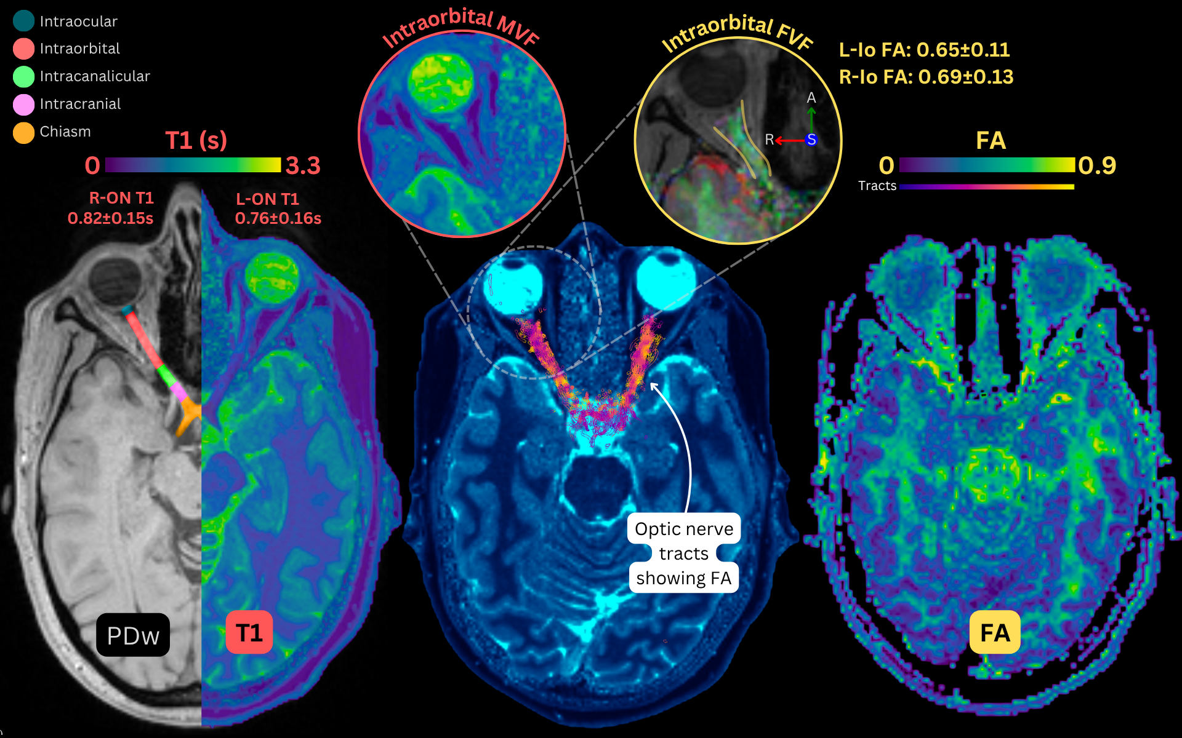
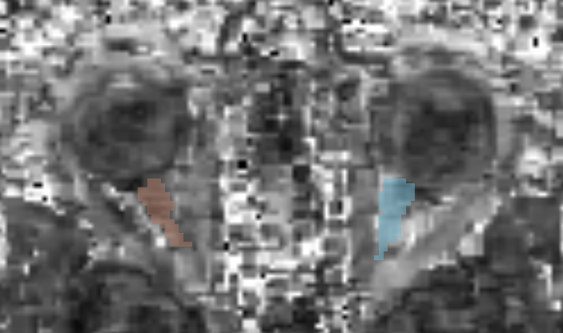
Background
Fiber Volume Fraction (FVF)
Fractional Anisotropy (FA)
$$FVF=0.883{FA}^{2}−0.082FA+0.074$$
Diffusion MRI ⟹ FA Map
Axial View of a FA Map
(Stikov et al., 2011)
Notes:
Accurate g-ratio estimation requires integrating myelin-sensitive and axon-sensitive MRI modalities.
MP2RAGE provides robust T1 mapping, from which myelin volume fraction (MVF) can be derived.
Diffusion-weighted imaging (DWI) allows computation of fractional anisotropy (FA), which correlates with axonal density and enables estimation of the fiber volume fraction (FVF).
Current literature lacks standard methods to fuse these data in small structures like the optic nerve.

Slide 6
Objectives
Primary Objective: Develop a pipeline for mapping the g-Ratio of the optic nerve
Secondary Objectives:
Co-register MP2RAGE and DWI to a common space (MNI152).
Extract T1 and FA from both MRI modalities
Compute MVF from T1 maps and FVF from FA maps.
Calculate g-ratio along the optic nerve and compare across patients

Slide 7
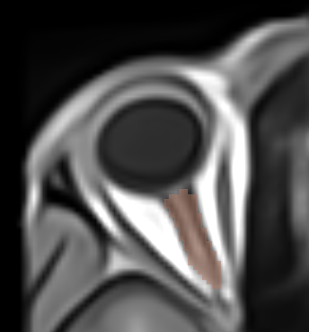
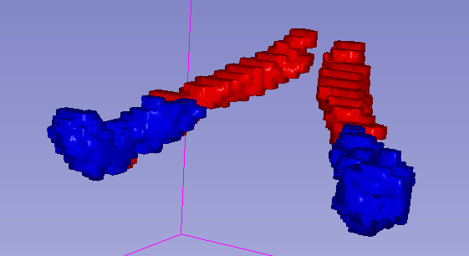
Data:
MP2RAGE raw image
DWI image
Max probability label from MR-EYE Atlas
MNI 152 Template
Manuals segmentations of both MRI modalities
Max probability label
(Barranco Hernandez et al., 2024)
Manuals Segmentations
Blue : DWI Segmentation
Red : MP2RAGE Segmentation

Slide 8
Methods:
Preprocess MP2RAGE and DWI images
Register MP2RAGE and DWI to MNI152
Compute segmentation overlap and compare with max probability label
From MP2RAGE: Extract T1 values → derive MVF
From DWI: Extract FA values → derive FVF
Compute g-ratio per slice​ ​

Slide 9



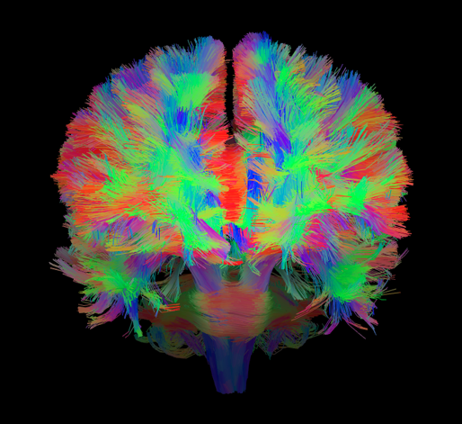
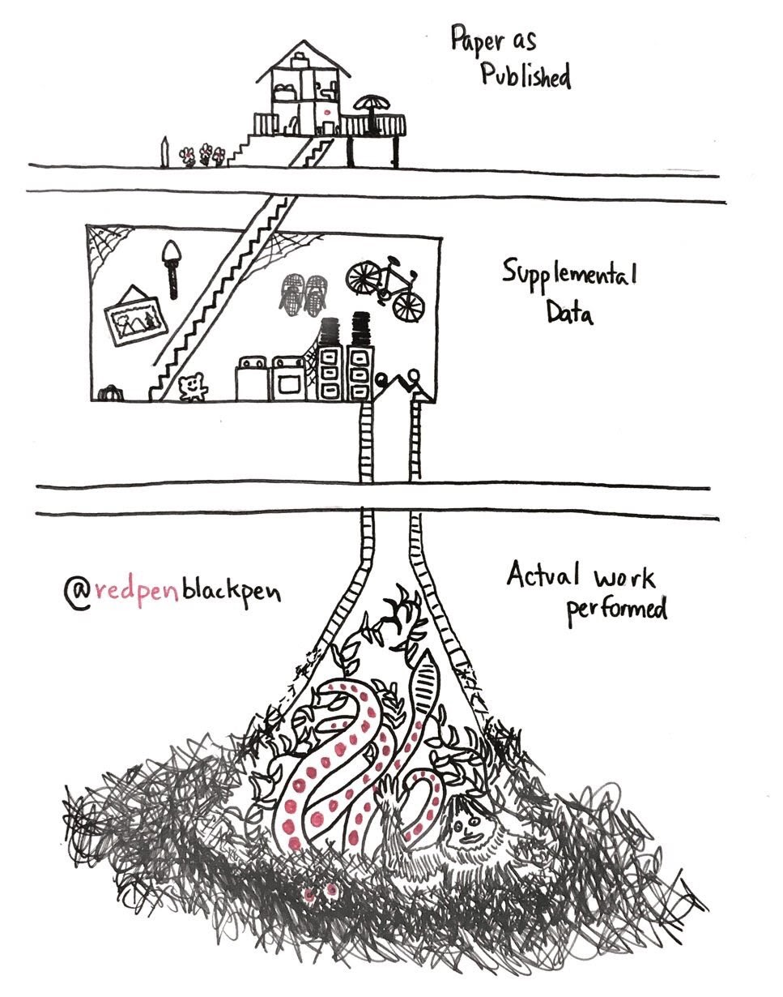


Tools:
(BRAINHACK SCHOOL, 2025)

Slide 10
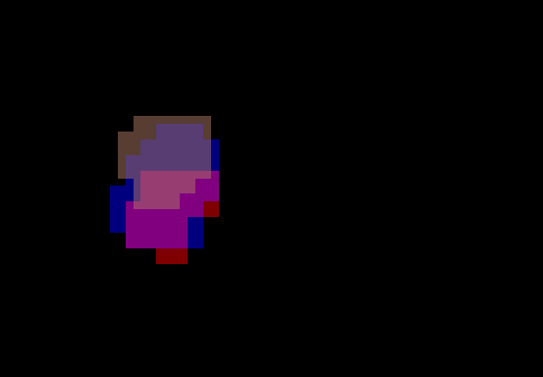

Results - Registration Quality
MP2RAGE and DWI overlap : 80%
Dice coefficient : 50%
Manuals Segmentations
Blue : DWI Segmentation
Red : MP2RAGE Segmentation
Coronal Plane Overlap
Brown : Max probability label

Slide 11
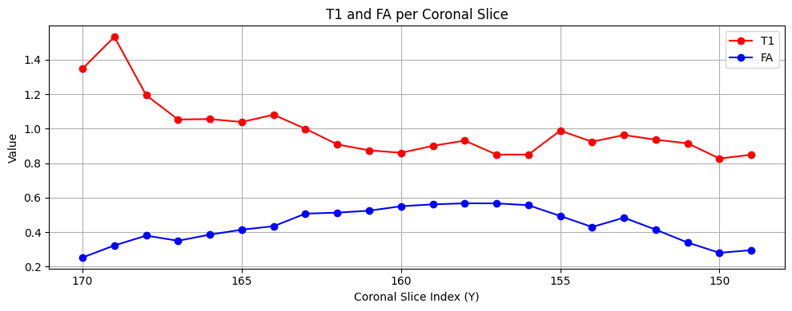
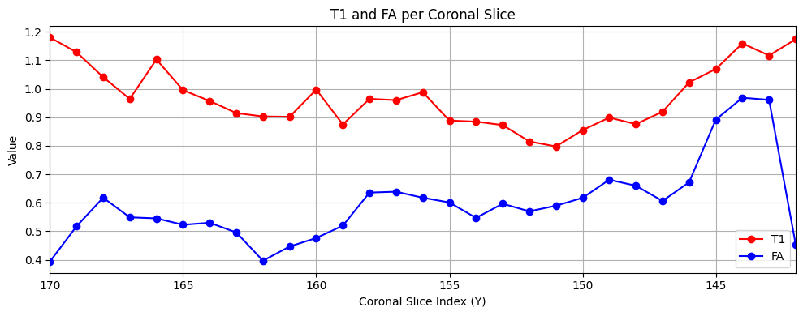
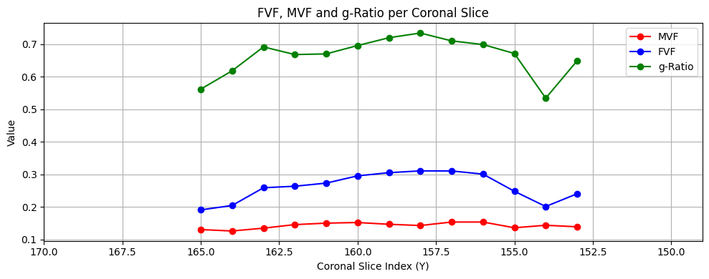
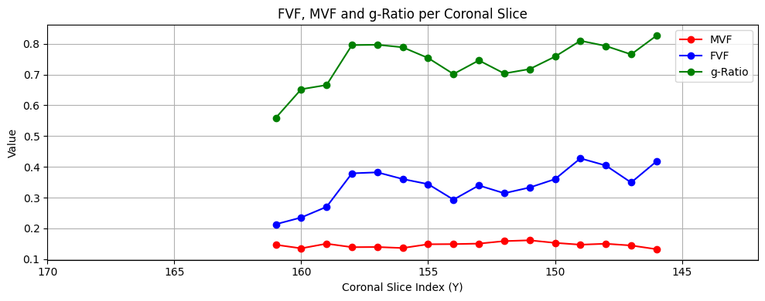
Results – MVF, FVF & g-Ratio
Subject 0204
Subject 0457
T1 Values
FA Values
g-Ratio
FVF Values
MVF Values

Slide 12
Results – MVF, FVF & g-Ratio
Subject 0204
Subject 0457

Slide 13
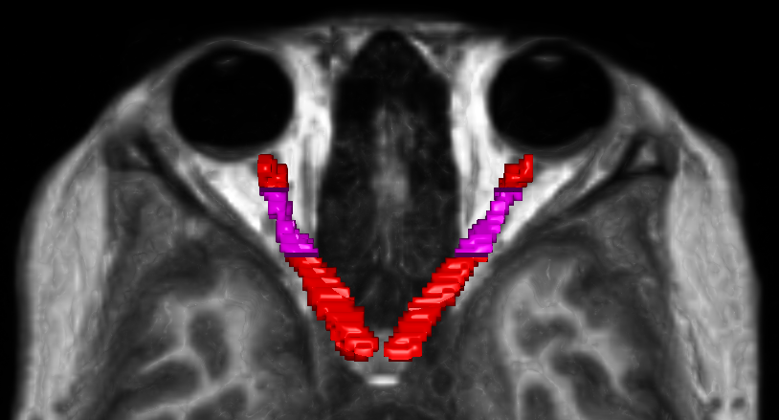
Results - Registration Quality
Segmentation ROI

Slide 14
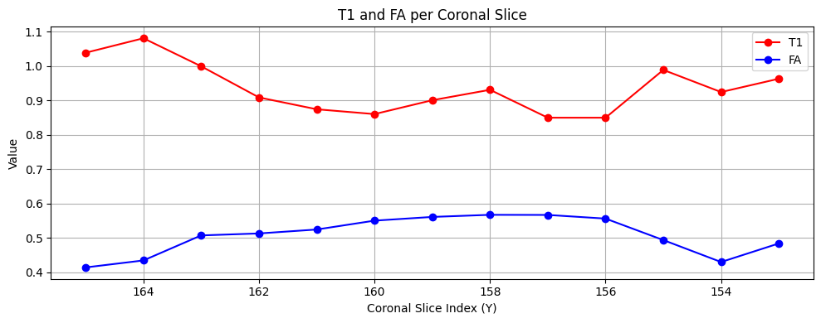
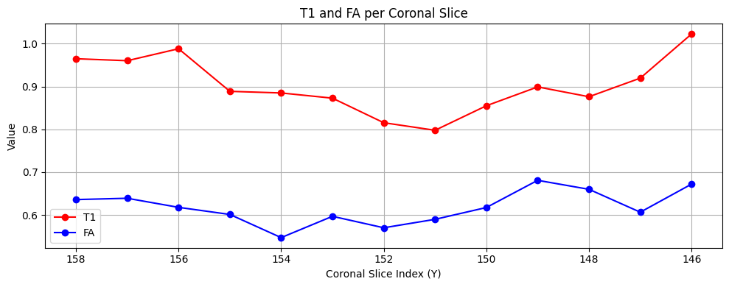
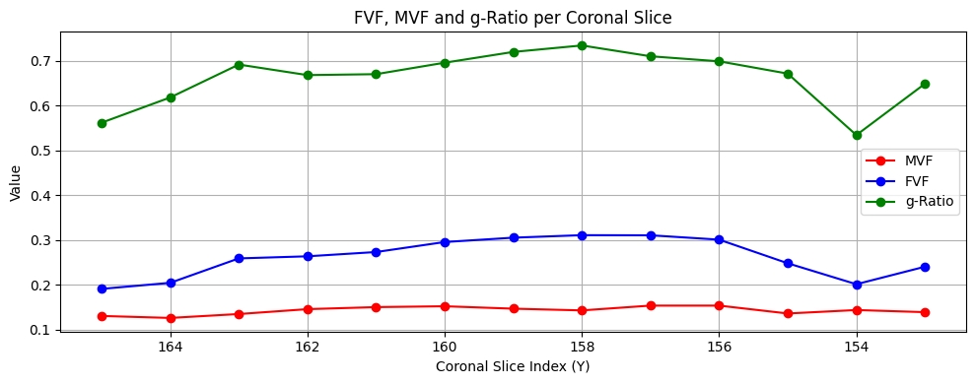
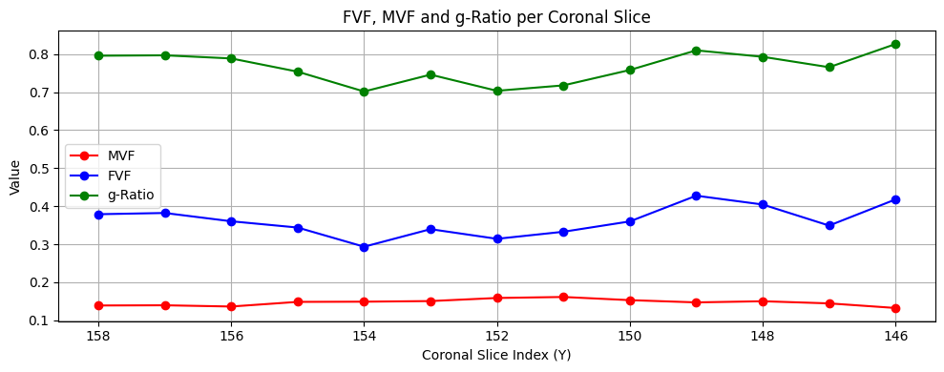
Results – MVF, FVF & g-Ratio
Subject 0204
Subject 0457
T1 Values
FA Values
g-Ratio
FVF Values
MVF Values

Slide 15


Deliverables
Reproducible pipeline
Jupyter Notebooks
Example Dataset
Method for g-ratio map of the optic

Slide 16
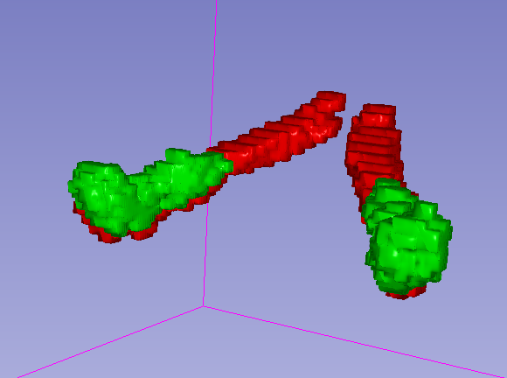
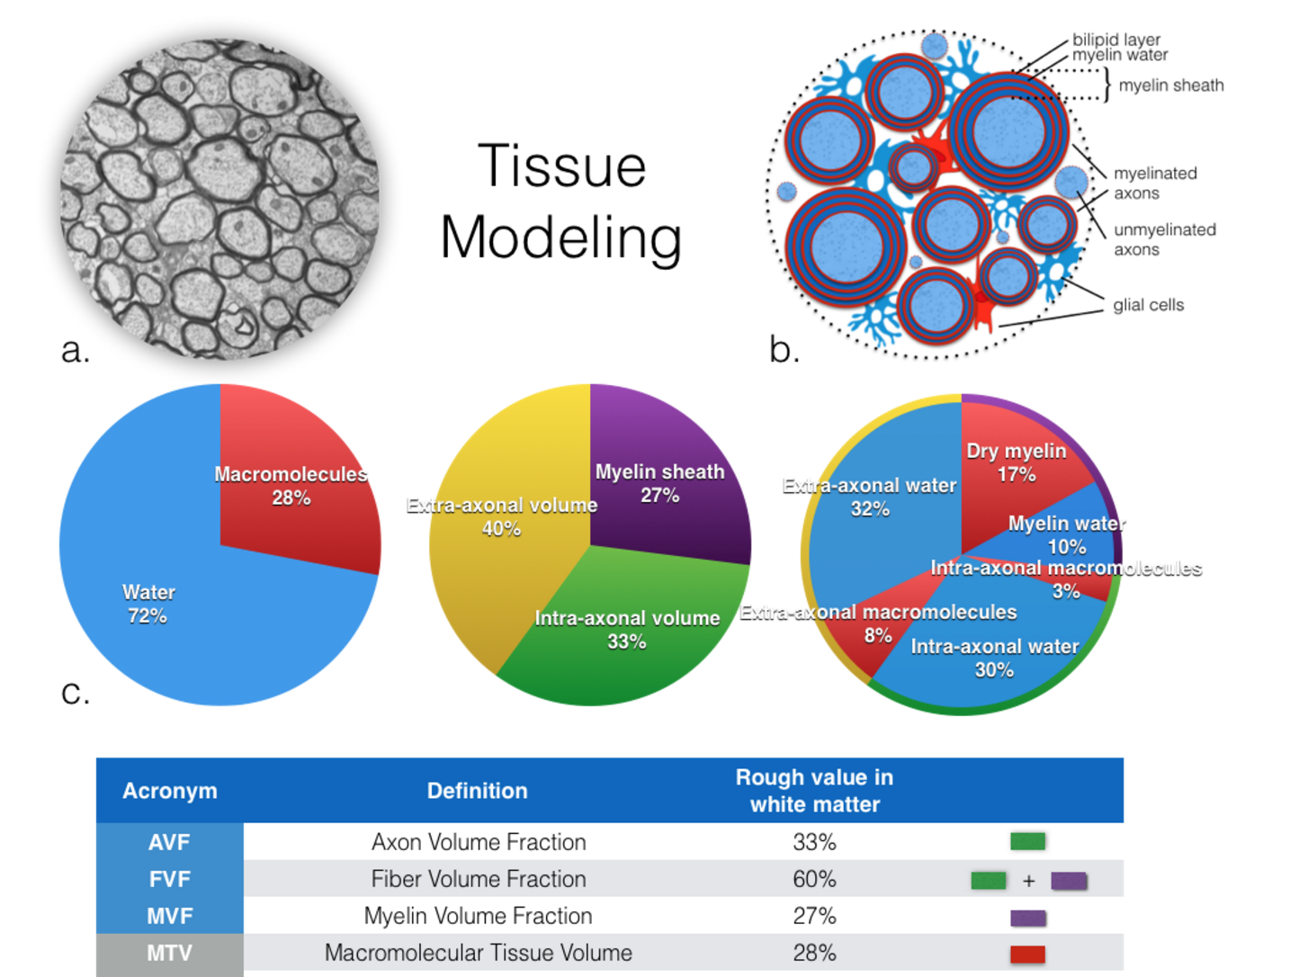
Conclusion
Registration issue : Rigid, Affine and Elastic
MTVF vs MVF
Manuals Segmentations
(Duval et al., 2017)

Slide 17
References
Barranco Hernandez, J., Luyken, A., Kebiri, H., Stachs, P., Macias Gordaliza, P., Esteban, O., Aleman Gomez, Y., Sznitman, R., Stachs, O., Langner, S., Franceschiello, B., & Bach Cuadra, M. (2024). Eye-Opening Advances: Automated 3D Segmentation, Key Biomarkers Extraction, and the First Large-Scale MRI Eye Atlas. https://doi.org/10.1101/2024.08.15.608051
Brainhack school. (n.d.). Retrieved May 29, 2025, from https://school-brainhack.github.io/
brainhack-school2025/albert-plante_project. (2025). Brainhack School 2025. https://github.com/brainhack-school2025/albert-plante_project (Original work published 2025)
Duval, T., Stikov, N., & Cohen-Adad, J. (2017). Modeling white matter microstructure. Functional Neurology, 31(4), 217–228. https://doi.org/10.11138/FNeur/2016.31.4.217
How Does Multiple Sclerosis Affect the Body? | Ausmed. (2025). Retrieved June 12, 2025, from https://www.ausmed.com/learn/articles/multiple-sclerosis-nursing-care
Mezer, A., Yeatman, J. D., Stikov, N., Kay, K. N., Cho, N., Dougherty, R. F., Perry, M. L., Parvizi, J., Hua, L. H., Butts-Pauly, K., & Wandell, B. (2013). Quantifying the local tissue volume and composition in individual brains with MRI. Nature Medicine, 19(12), 1667–1672. https://doi.org/10.1038/nm.3390
NeuroLibre. (n.d.). Retrieved June 12, 2025, from https://neurolibre.org
Rokers Vision Laboratory. (n.d.). Retrieved May 30, 2025, from https://sites.nyuad.nyu.edu/rokersvisionlaboratory/
Stikov, N., Campbell, J. S. W., Stroh, T., Lavelée, M., Frey, S., Novek, J., Nuara, S., Ho, M.-K., Bedell, B. J., Dougherty, R. F., Leppert, I. R., Boudreau, M., Narayanan, S., Duval, T., Cohen-Adad, J., Picard, P.-A., Gasecka, A., Côté, D., & Pike, G. B. (2015). In vivo histology of the myelin g-ratio with magnetic resonance imaging. NeuroImage, 118, 397–405. https://doi.org/10.1016/j.neuroimage.2015.05.023
Stikov, N., Perry, L. M., Mezer, A., Rykhlevskaia, E., Wandell, B. A., Pauly, J. M., & Dougherty, R. F. (2011). Bound Pool Fractions Complement Diffusion Measures to Describe White Matter Micro and Macrostructure. NeuroImage, 54(2), 1112–1121. https://doi.org/10.1016/j.neuroimage.2010.08.068
Trust, M. S. (n.d.). McDonald criteria | MS Trust. Retrieved May 29, 2025, from https://mstrust.org.uk/a-z/mcdonald-criteria

